Slide 1
Microsoft Azure Services Platform
Microsoft Offers a Number of Cloud services for organizations of any size.
Azure Services Platform is a cloud computing and services platform hosted in Microsoft datacenters.
Offers a Cloud operating system and developer tools for developing applications with industry standard protocols like REST, SOAP, XML and HTTP.

Slide 2
Azure Services Platform Components
Windows Azure
SQL Services
.NET Services
Live Services

Slide 3
Windows Azure
Windows Azure is a Cloud-based Operating System.
Provides the Development, hosting, and service management environment to Azure Services Platform.
Supports existing standards like SOAP, REST, and XML.
Developers can use the Visual Studio skills to build applications and services

Slide 4
Uses of Windows Azure
Widows Azure can be used to
Add Web Service applications to existing applications
Build and Modify applications and then move them onto the Web
Make, test, debug, and distribute web services efficiently and inexpensively
Reduce the cost of IT Management

Slide 5
Windows Azure Components
 | Windows Azure PaaS
Applications | Windows Azure Service Model
Runtimes | .NET 3.5/4, ASP .NET, PHP
Operating System | Windows Server 2008/R2-Compatible OS
Virtualization | Windows Azure Hypervisor
Server | Microsoft Blades
Database | SQL Azure
Storage | Windows Azure Storage (Blob, Queue, Table)
Networking | Windows Azure-Configured Networking

Slide 6














The Windows Azure Platform
Developer Experience
Use existing skills and tools.
services
AppFabric
Compute
Storage
Management
Network
Relational data
Management
Connectivity
Access control

Slide 7
SQL Services
Microsoft SQL Services extend SQL Server capabilities to the cloud as web-based services.
Allows Storage of Varieties of data
Structured Data
Semistructured Data
Unstructured Data
Delivers a set of Integrated Services that allow
Relational Queries
Search
Reporting
Data Analytics
Integration and Synchronization of data

Slide 8
SQL Database
DB
SQL Database
Relational SQL Server Engine in the Cloud
Clustered for high availability
Fully Managed Service
SQL Reporting support

Slide 9
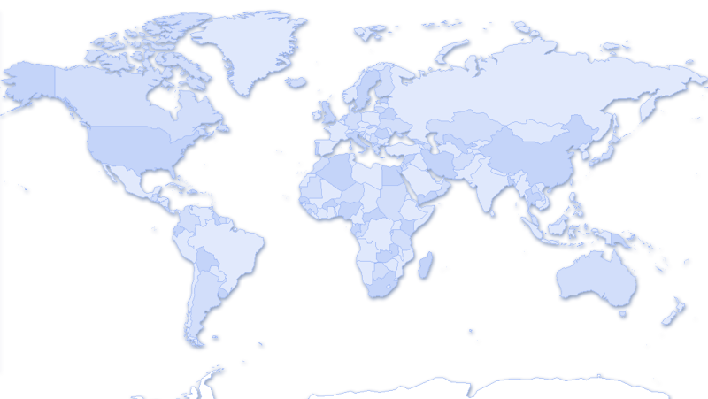

SQL Database Details
Multiple Physical Replicas
Single Logical
Database
Single Primary
Replica 1
Cloud relational database based on SQL Server engine
Use same tools, data access frameworks, T-SQL based language
Global datacenters
High Availability and Redundancy
Reads are completed at the primary
Writes are replicated to a quorum of secondaries
DB
Replica 2
Multiple
Secondaries
Replica 3

Slide 10
.NET Services
Microsoft .NET Services are a Set of Microsoft hosted, developer oriented services.
Provides components and high-level class libraries.
Similar to .NET Framework that help developers to focus more on their product development.
.NET services are also available to other development technologies through the use of industry standard protocols like REST, SOAP, and HTTP.

Slide 11
Live Services
Live Services is a development center and supplier of software development kits for Windows Live and Azure Services Platforms
Windows Live is a discontinued brand name for a set of web services and software products from Microsoft as part of their software plus services platform.
The Windows Live brand was phased out during August 2012, when Windows 8 was release to manufacturing

